Slide 1
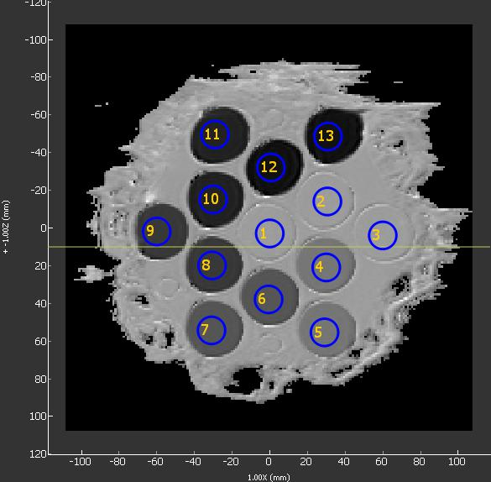
The phantom consists of 13 vials with variable PVP concentrations in water. The fill is in an ice bath to keep the temperature at 0 C.
NIST/RSNA/NCI Isotropic Diffusion phantom
40%
50%
50%
40%
water
30%
water
water
30%
10%
20%
10%
20%

